Slide 1


ABDELLAH EL AOUAD
CUSTOMER ENGAGEMENT ANALYSIS IN EXCEL PROJECT
DATA ANALYTICS PROJECT

Slide 2
CASE DESCRIPTION
In 2022, there were high expectations for the growth of the 365 company and increased student engagement based on the introduction of new website platform features. Some of these features included an XP system that enabled students to track their progress, level up, and earn rewards by completing various learning objectives.
Additionally, the company expanded its course library, covering a broader range of topics to provide its students with a richer set of skills and attract a larger audience. These enhancements were anticipated to positively impact the student experience, create an effective strategy for customer engagement, and contribute to the company's success in the coming year.

Slide 3
PROJECT’S GOAL
With this Customer Engagement Analysis in Excel, I must analyze whether the new additions to the platform have increased student engagement.

Slide 4

PROJECT FILES
The following information about the column values :
student_id – the unique identifier for each student in the dataset.
student_country – identifies the country of each student.
Paid – indicates whether a student had a paid account during the specified period. It is a binary variable.
minutes_watched_21 – represents the student’s engagement level in Q4 2021.
minutes_watched_22 – denotes the student’s engagement level in Q4 2022.

Slide 5




PROCESS OVERVIEW
To successfully complete this project, I followed a structured approach, which included the following key steps:
Descriptive Statistics
Confidence Intervals
Hypothesis Testing
Conclusion

Slide 6
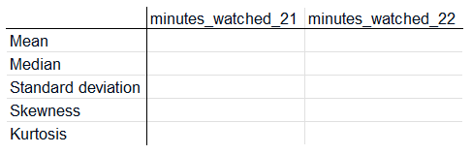
DESCRIPTIVE STATISTICS
Task 1
My first task was to provide insights into the relative engagement levels in Q4 2021 and Q4 2022. I did focus on low-engagement users (those who watched between 1 and 100 minutes in 2021).
During this task, I used the following functions to provide the desired insights:
=AVERAGE() : Mean
=MEDIAN()
=STDEV.S() : Standard deviation
=SKEW() : Skewness
=KURT() : Kurtosis

Slide 7
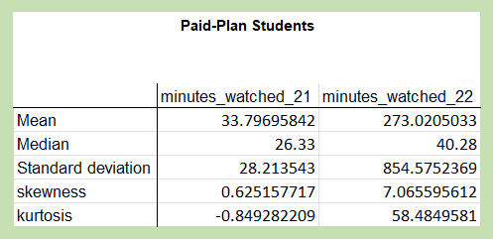
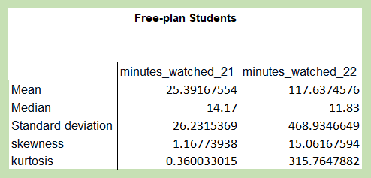
RESULTS 1
Paid-Plan Students (Low Engagement Group)
Mean: Increased from 33.80 to 273.02 minutes
Median: Increased from 26.33 to 40.28 minutes
Standard Deviation: Increased from 28.21 to 854.58 minutes
Free-Plan Students (Low Engagement Group)
Mean: Increased from 25.39 to 117.64 minutes
Median: Decreased from 14.17 to 11.83 minutes
Standard Deviation: Increased from 26.23 to 468.93 minutes
Distribution Shape
Skewness (Paid): Increased from 0.63 to 7.07 (right-skewed).
Skewness (Free): Increased from 1.17 to 15.06 (right-skewed).
Kurtosis (Paid): Increased from -0.85 to 58.48 (more outliers).
Kurtosis (Free): Increased from 0.36 to 315.76 (more extreme values).

Slide 8
INSIGHTS
Paid-Plan Students (Low Engagement Group)
Significant engagement increase, but high variability in 2022 suggests diverse engagement levels.
Free-Plan Students (Low Engagement Group)
Moderate engagement increase, driven by a few students; typical student engagement declined.
Paid vs. Free-Plan Comparison
Engagement Growth: Higher for paid-plan students.
Variability: Increased more for free-plan students, suggesting more outliers.

Slide 9
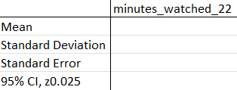

CONFIDENCE INTERVALS
Task 2
The following task was about determining the minute interval for each of the four groups, within which I can be 95% confident that a randomly selected individual will be situated.
During this task, I used the following functions and equations:
=AVERAGE() : Mean
=STDEV.S() : Standard deviation
Standard Error = STDEV.S()/SQRT(COUNT())
95% CI, z0.025 = 1.96
CI low = MEAN()-(95% CI, z0.025) / Standard Error
CI high = MEAN()-(95% CI, z0.025) / Standard Error

Slide 10
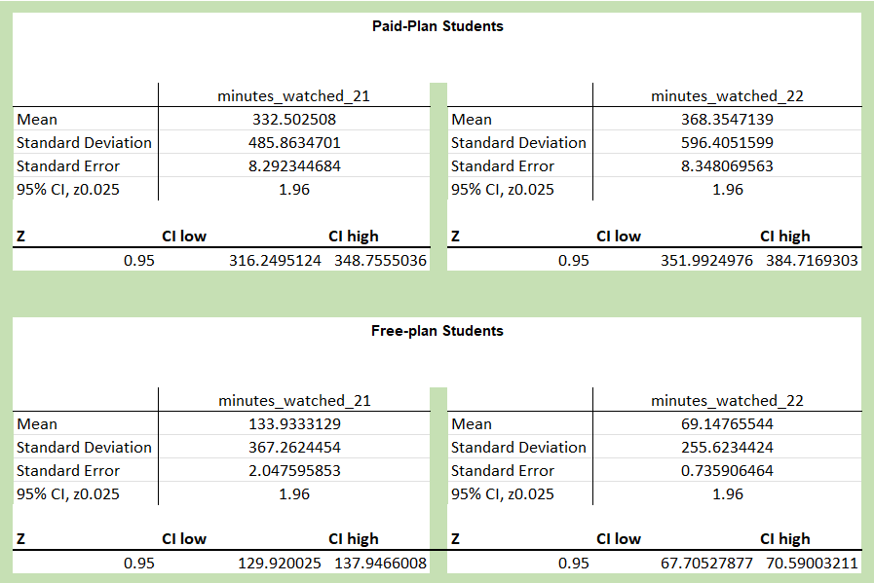
RESULTS 2
Paid-Plan Students:
There was an increase in engagement for paid-plan students from Q4 2021 to Q4 2022. The confidence interval for the average minutes watched by paid-plan students increased from Q4 2021 (316.25 to 348.76 minutes) to Q4 2022 (351.91 to 384.72 minutes). This suggests that we can be 95% confident that the true average minutes watched by all paid-plan students in the population increased from Q4 2021 to Q4 2022.

Slide 11
RESULTS 2
Paid-Plan Students:
Among free-plan students, there's a decrease in engagement from Q4 2021 to Q4 2022. The confidence interval for the average minutes watched decreased from Q4 2021 (129.92 to 137.95 minutes) to Q4 2022 (67.71 to 70.59 minutes). We then can be 95% confident that the true average minutes watched by all free-plan students in the population decreased from Q4 2021 to Q4 2022.

Slide 12
INSIGHTS
Comparison between Paid- and Free-Plan Students (Q4 2022)
Students with a paid-plan subscription watch substantially more than those without. The confidence interval for the average minutes watched in Q4 2022 was 67.71 to 70.59 minutes for free-plan students and 351.99 to 384.72 minutes for paid-plan students. We then can be 95% confident that paid-plan students watched significantly more minutes than free-plan students in Q4 2022. This aligns with the expectation that paid-plan students who have invested in the platform tend to be more engaged than free-plan users.

Slide 13
HYPOTHESIS TESTING
Task 3
The null hypotheses should include the following:
The engagement (minutes watched) in Q4 2021 is higher than or equal to the one in Q4 2022 (μ1 ≥ μ2). We test free-plan and paying students separately.
To test this hypothesis I will perform a "t-Test: Two-Sample Assuming Unequal Variances"
(The test results are in the analysis sheet)

Slide 14
SUMMARY
Paid-Plan Students
With a t-statistic of -3.05 (less than the critical value of -1.645), you would reject the null hypothesis because the negative t-statistic indicates that (the mean minutes watched by students in Q4 2021) is significantly smaller than (the mean minutes watched by students in Q4 2022). This is contrary to the null, so we reject it. Of course, rejecting the null hypothesis does not confirm the alternative hypothesis; it suggests that the data provide enough evidence against the null hypothesis.
Free-Plan Students
For free-plan students: With a t-statistic of 29.78 (greater than the critical value of -1.645), you would fail to reject the null hypothesis. This means there’s not enough evidence to conclude that μ1μ1 is smaller than μ2μ2. So, the data supports the null hypothesis that μ1μ1 is larger than or equal to μ2μ2.

Slide 15
CONCLUSION
The cost to the company of each type of error would depend on the implications of incorrectly concluding that engagement has increased—potentially leading to over-investment in certain features or complacency about needing to improve features—versus incorrectly concluding that engagement has not increased—potentially missing out on recognizing successful features or identifying areas that need improvement.

